Slide 1
Idea 1: Fukushima’s Fallout
Creative Brief: [Combat]

Slide 2
Combat (Loud)
Combat style will be like Metro 2033, but feels like The Last Of Us / The Division.
Characteristics:
No HP bar / damage done for enemies
Visual cues to see how close enemy is to dying (Blood spots, etc)
HP-based, but realistic (Headshot = instant death for most enemies)
Very, VERY, limited ammo

Slide 3
In-game functionality (Loud)
Metro 2033 Combat Gameplay
The Division Combat Gameplay

Slide 4
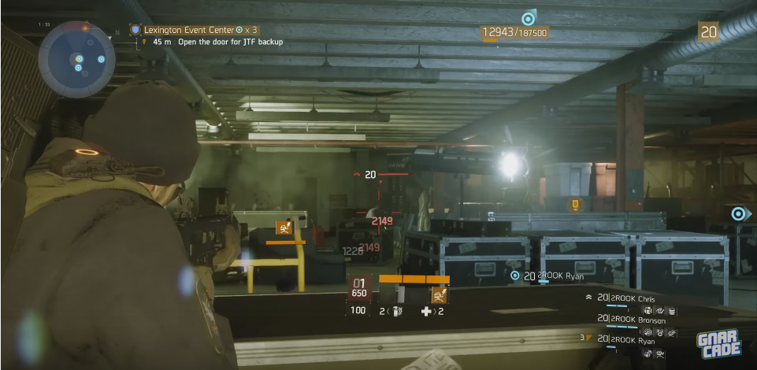
References (Videos / Images)

Slide 5
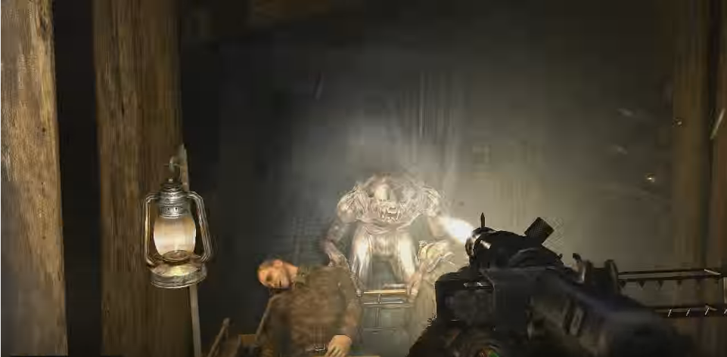
References (Videos / Images)

Slide 6
Combat (Stealth)
Stealth combat will be similar to The Last Of Us’s stealth
Characteristics:
Shanking will be 1-hit for most enemies (Unlimited uses)
Mutated humans will be aggro’d if player makes too much noise (Walking, shooting)

Slide 7
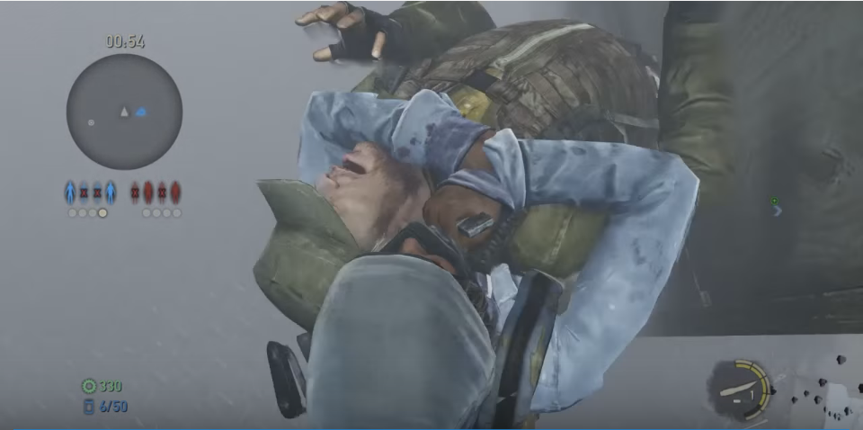
In-game functionality (Stealth)
The Last Of Us Gameplay

